Slide 1
Welcome To Just IT
Software Development
Skills Bootcamp
Chris Barling
Senior Careers Consultant

Slide 2

About us

Slide 3

Why People Choose Just IT
20 years of expertise
Over 7000 people have gained jobs through Just IT
Over 600 people like you have recommended Just IT in the last three years
https://uk.trustpilot.com/review/www.justit.co.uk
We have a 4.7 “Excellent” rating on TrustPilot and a 4.4 rating on Google My Business”

Slide 4
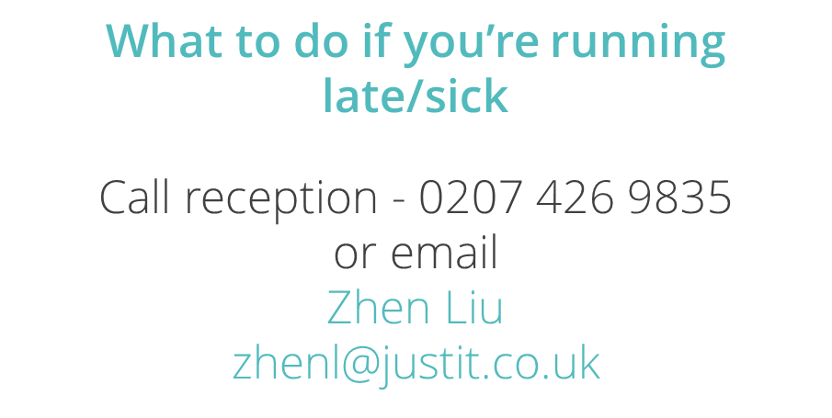
Course Attendance
Technical Training hours
9:00am – 12:30pm
Mon – Fri

Slide 5
Course Attendance
Career Support Sessions
Mon/Weds/Thurs (varying each week)
1:30pm – 2:30/3:00pm

Slide 6
The Team Behind You
Narayan
HTML, CSS, JavaScript, Python, ASP.NET
Abdul
HTML, CSS, JavaScript, Python, ASP.NET
Tim
Technical Trainers
HTML, CSS, JavaScript,
Regina Business Support
Business
Support
Matt: Operations Director
Zhen: Delivery Coordinator
Akber: Candidate Engagement
Victoria: Candidate Engagement

Slide 7
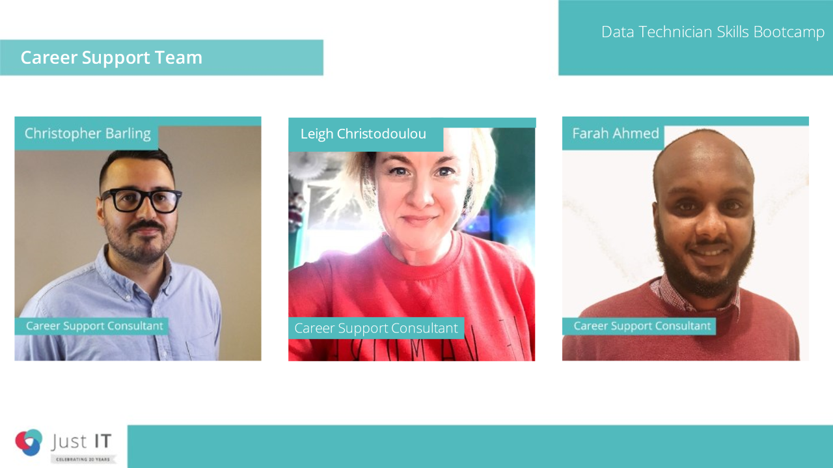
Career Support Team

Slide 8
Course structure
12 weeks, Full-time, Mon – Fri.
1:30pm – 2:30pm/3:00pm IAG sessions (Mon/Wed/Thurs)
9:00am – 12:30pm - Tech Training
1:30am – 5:00pm – Self Study (when not on an ILT session)

Slide 9
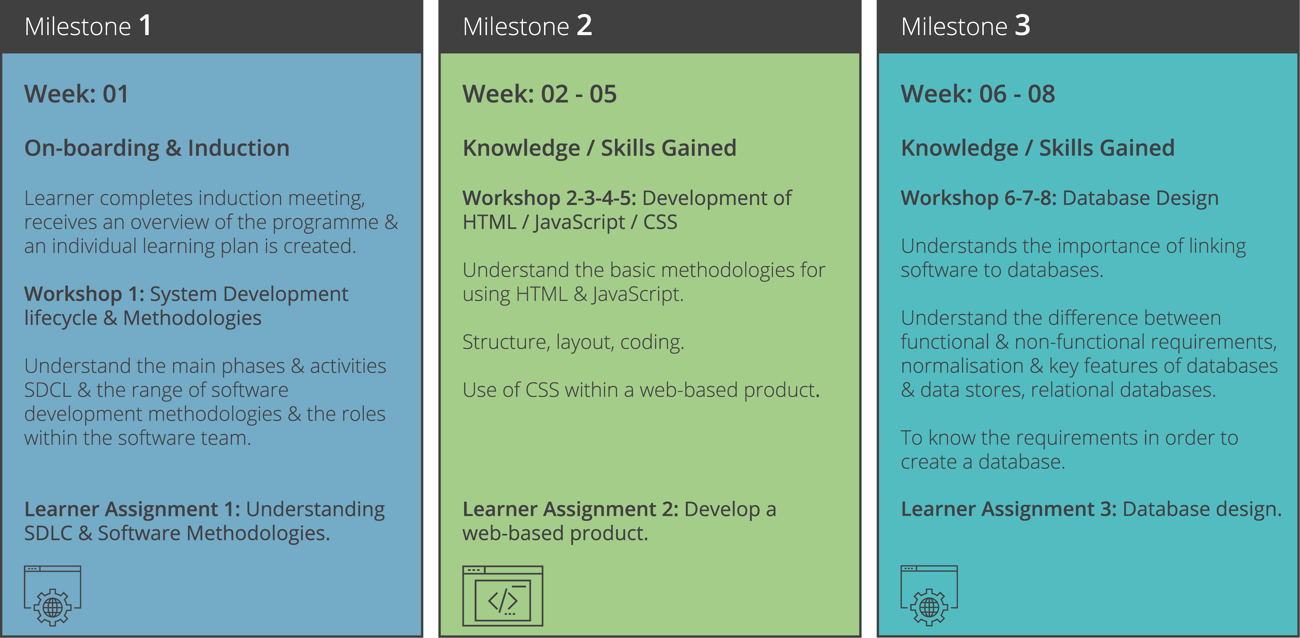
Learner journey for Skills Bootcamp in Software Development

Slide 10
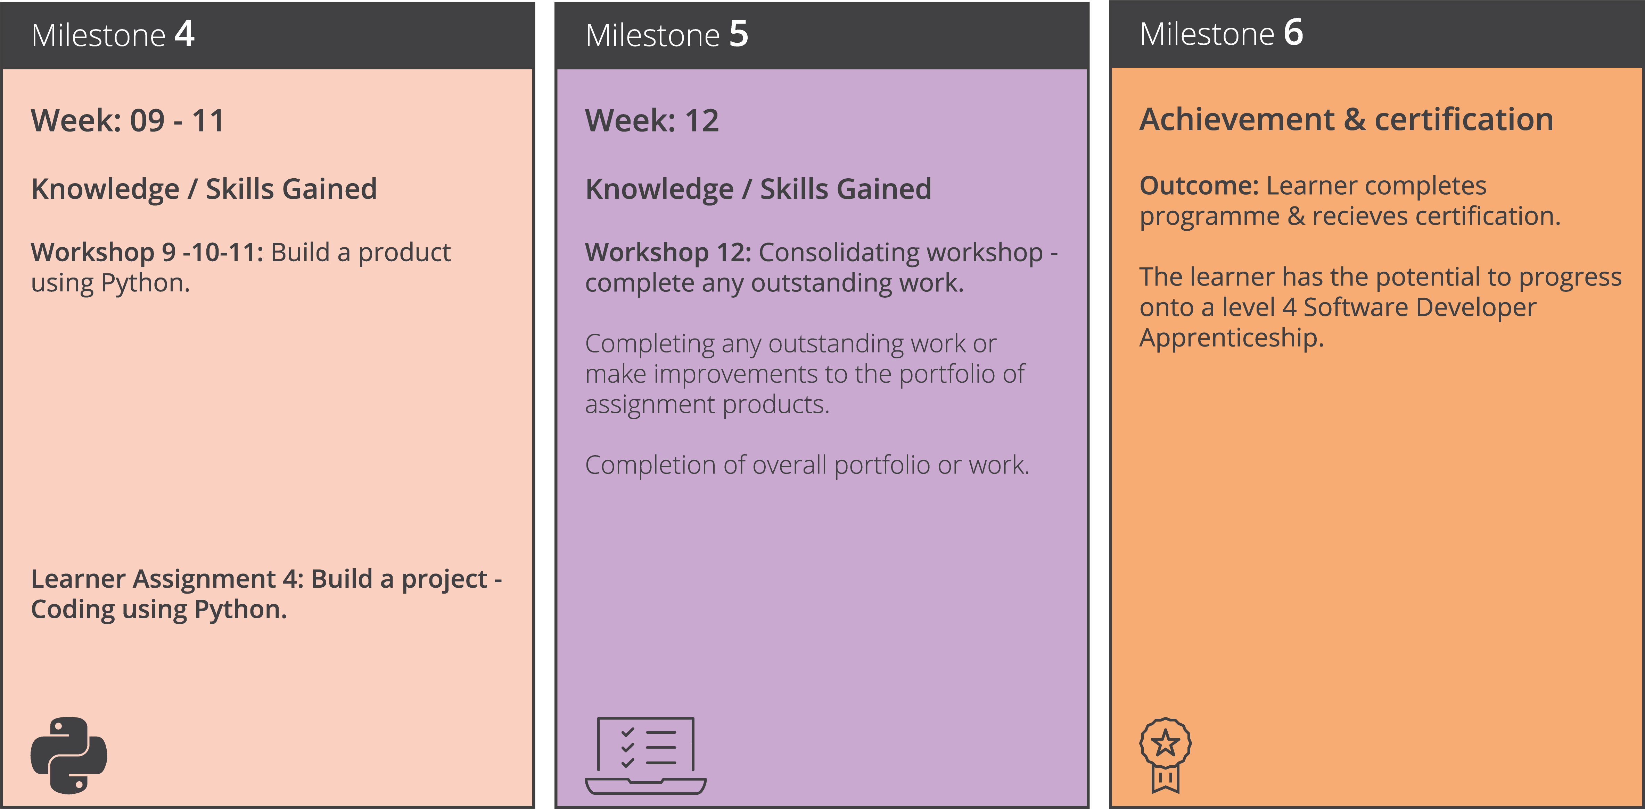
Learner journey for Skills Bootcamp in Software Development

Slide 11
Microsoft Teams / Remote Sessions
Camera’s on throughout all training sessions – This is an Ofsted requirement
Utilise the chat function during
Interact with the thumb's up icon, applause, smiley face etc
Be ready for prompts/questions
Make sure you are in a suitable environment
Diary management and attending sessions - you must complete 80% of your hours in order for us to support you after the 12 weeks.

Slide 12
Why are you here?
Start a new career in tech!
Develop your technical skills
Develop your soft skills
CV Support / Interview Skills
Professionalism / Self Management
Improve your confidence
Meet people with similar interests and career goals
Job Searching Techniques

Slide 13
How we help you
Training / Career Support / Recruitment
By being honest and truthful
Identifying your strengths and weaknesses
Developing your weaknesses
Working with you as individuals

Slide 14
Do Your best
Studying
Communication
Punctuality
Commitment and focus is everything

Slide 15
Potential Future outcomes
Online Portfolio - To showcase your skills
Level 4 Software Development Apprenticeship
Junior Development role.
Other Learning Providers.

Slide 16
Expectations
Professionalism
Respond to calls and emails within 48 hours (we’ll do the same)
Full course attendance - Technical Training and Employability sessions
Survey and declaration of learning every Friday
Interview offer email and Job Offer milestone shares for DFE
Work with us.

Slide 17
Feedback Fridays
Friday’s – survey in the last 20 mins of the day
What is working well?
How can we improve?

Slide 18
Escalation Process
You should expect to receive a response from us within 48 hours.
If you have a technical query, you should contact the relevant Technical Trainer.
For all other query's you should contact your Career Support Consultant.
If no contact and/or you have an issue /complaint to raise contact:
Matt Elson– Bootcamps Director - matte@justit.co.uk
Mobile - 07956 901593 Teams - 02074269843

Slide 19




Follow us
Facebook
weareJIT/
Twitter
@weareJIT
LinkedIn
/company/just-it
Instagram
@wearejustit

Slide 20
Thankyou!
Any questions?

